Slide 1
Platzgraff.com
Platzgraff.com
Platzgraff.com
Platzgraff.com
Mikasa.com
Macys.com
Mikasa.com
BBB.com
Kohls.com
Wayfair.com
Kohls.com
Mikasa.com
Belk.com
Walmart.com

Slide 2
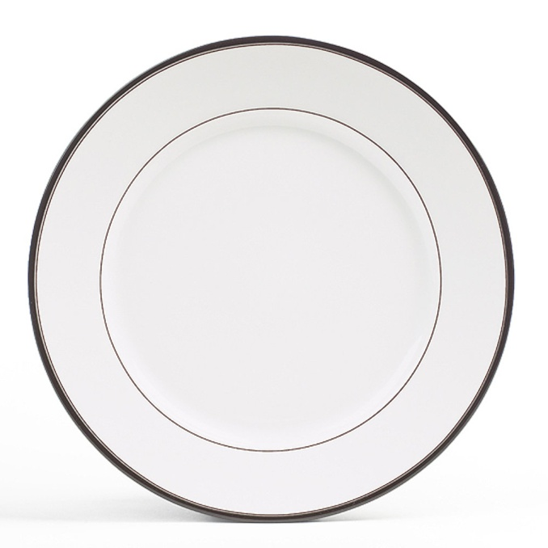
FL1 XXXX-YY
SL170-201
Cocoa Blossom Dinner Plate
Quantity to PICK = 7
Platzgraff.com
Platzgraff.com
Platzgraff.com
Platzgraff.com
Mikasa.com
1
Macys.com
4
Mikasa.com
BBB.com
Kohls.com
Wayfair.com
Kohls.com
Mikasa.com
2
Belk.com
Walmart.com
SL170-201
Cocoa Blossom Dinner Plate

Slide 3
FL1 XXXX-YY
SL170-201
Cocoa Blossom Dinner Plate
Quantity to PICK = 7
Platzgraff.com
Platzgraff.com
Platzgraff.com
Platzgraff.com
Mikasa.com
1
Macys.com
4
Mikasa.com
BBB.com
Kohls.com
Wayfair.com
Kohls.com
Mikasa.com
2
Belk.com
Walmart.com
SL170-201
Cocoa Blossom Dinner Plate

Slide 4
FL1 XXXX-YY
SL170-201
Cocoa Blossom Dinner Plate
Quantity to PICK = 7
Platzgraff.com
Platzgraff.com
Platzgraff.com
Platzgraff.com
Mikasa.com
1
Macys.com
4
Mikasa.com
BBB.com
Kohls.com
Wayfair.com
Kohls.com
Mikasa.com
2
Belk.com
Walmart.com
SL170-201
Cocoa Blossom Dinner Plate

Slide 5
FL1 XXXX-YY
SL170-201
Cocoa Blossom Dinner Plate
Quantity to PICK = 7
Platzgraff.com
Platzgraff.com
Platzgraff.com
Platzgraff.com
Mikasa.com
Macys.com
Mikasa.com
BBB.com
Kohls.com
Wayfair.com
Kohls.com
Mikasa.com
Complete
Belk.com
Walmart.com
SL170-201
Cocoa Blossom Dinner Plate

Slide 6
Platzgraff.com
Pfaltzgraf.com
Complete
Platzgraff.com
Platzgraff.com
Mikasa.com
Complete
Macys.com
Mikasa.com
Complete
BBB.com
Kohls.com
Wayfair.com
Complete
Kohls.com
Mikasa.com
Complete
Belk.com
Walmart.com
SL170-201 Cocoa Blossom Dinner Plate 2 pieces
SL170-220 Cocoa Blossom Rim Soup 2 pieces
SL170-212 Cocoa Blossom Tea Cup and Saucer 2 pieces

